Slide 1
COLLEGE OF INFORMATION AND COMMUNICATION TECHNOLOGY(CoICT).
PROJECT TITLE: SCHOOL BUS TRACKING MANAGEMENT SYSTEM
STUDENT NAME: NGAKWIRA,TUMANIEL T. 2020-04-09497 Bsc in CS.
MWAISELA, PETER ABEL. 2020-04-08600 Bsc in BIT.
SUPERVISOR NAME: Mr. MARCO MASEMBO.

Slide 2
Presentation outline
Requirements gathering and analysis
Process modeling Introduction
Requirements gathering
Functional requirements
Non functional requirements
Use case diagram.
Class diagram
System design
Architecture design
Process modeling: context diagram.
ER- Diagram

Slide 3
Requirement gathering and analysis.
Introduction of the system
School Bus Tracking Management System is a web based and mobile based system which keep parents direct informed and easily notified about the movement of their children in school bus.
It monitor pick-up/ drop-off points of students to enhance safety of the children during their daily movement to and from school

Slide 4
Requirements gathering
This involves collection of data from our stakeholders i.e., the school Admin, parents and drivers. The technique used in gathering data was as follows;
Interview
We prepared open-ended questions that used to interview the school Admin, drivers and parents. From collected data we were able to generate a list of requirements such as functional and non-functional requirements.

Slide 5
Functional requirements
s/n | Functional requirements
 | Users Management The system should allow users to be registered in the system. The system should authenticate users and redirect them to their specified profiles.
 | Routes Management System should allow School Admin register buses and assign them to drivers. System should allow School Admin to plan bus routes
 | Global position System (GPS) tracking System should allow user to get real time information of the bus
 | Emergence managements. System should allow a driver to declare emergence example car breakdown. System should allow parent to declare student’s emergence

Slide 6
Non functional requirements
s/n | Attributes | constraints
1 | Usability | The system must be easy to use and understand to both Administrator and parents.
2 | Compatibility | The system must be compatible with variety of devices include Computers, smart phone and tablets
3 | Performance | The system must provide real time update about bus location and arrival time and respond quicky to the user request.
4 | Reliability | The system must be dependable and consistently and deliver an accuracy information about bus location and arrival time.

Slide 7
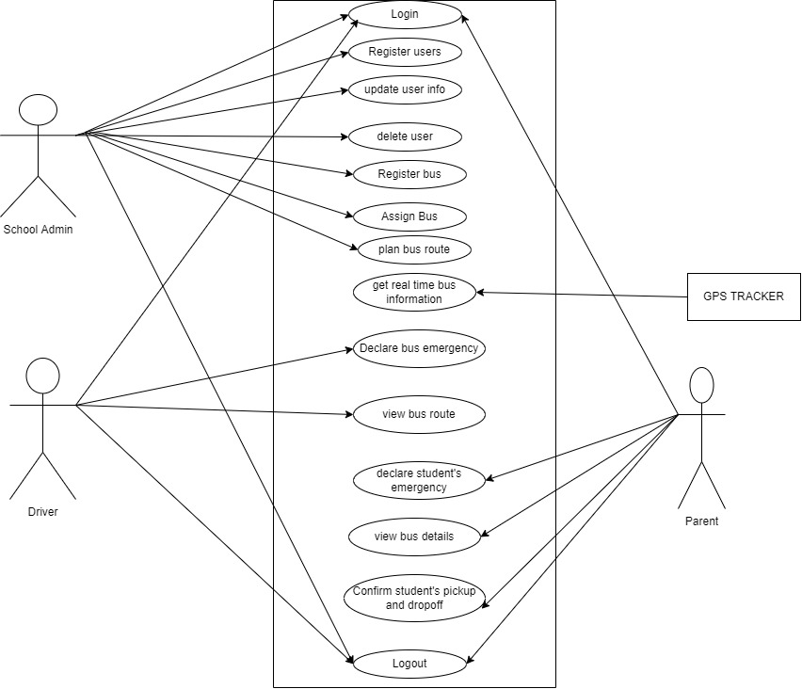
use case diagram

Slide 8
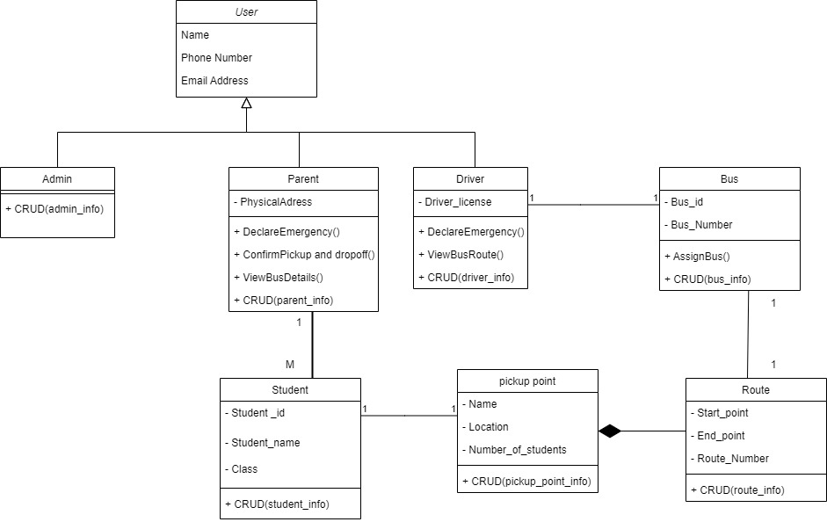
Class diagram

Slide 9
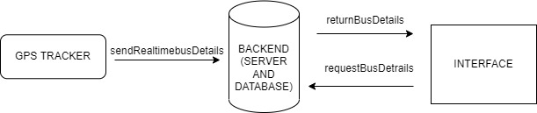
System design
Architecture design

Slide 10
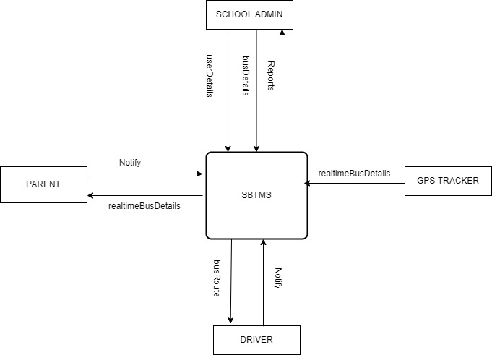
Process modeling: context diagram

Slide 11
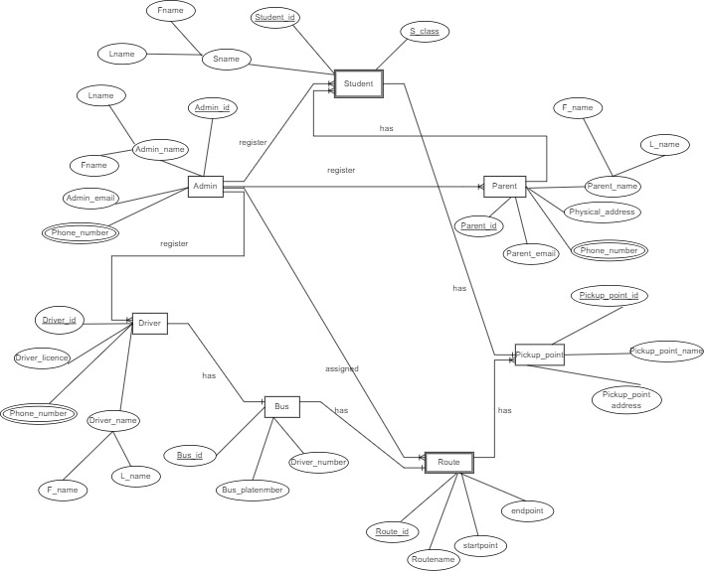
ER- Diagram

Slide 12
Work done so far
Establishing system requirement
System analysis and design

Slide 13
Work to be done
System implementation/coding
Evaluating system performance

Slide 14
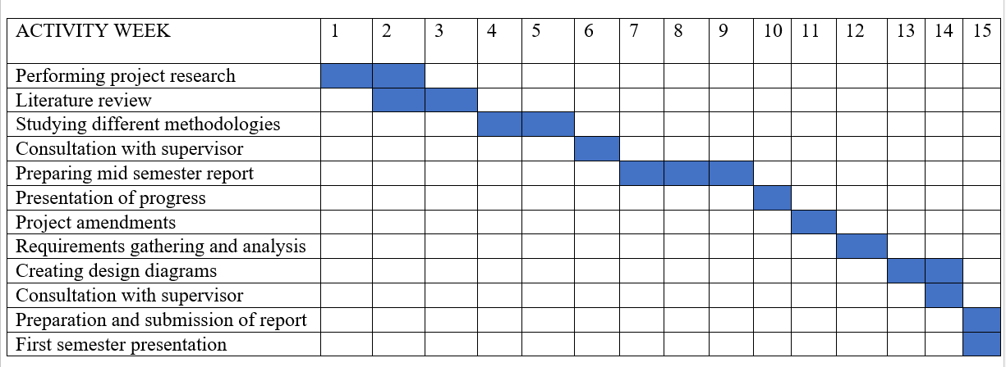
Time scheduling

Slide 15
Thank you

